Slide 1
Inductors in Parallel

Slide 2
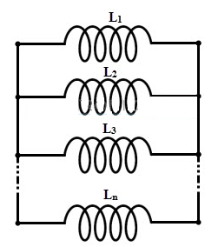
Inductors are said to be connected in parallel when two terminals of an inductor respectively connected to each terminal of other inductors or inductor.
Similar to the parallel connection of resistors, the total inductance in parallel connection of inductors is somewhat lesser than smallest inductance of an inductor in that connection.

Slide 3
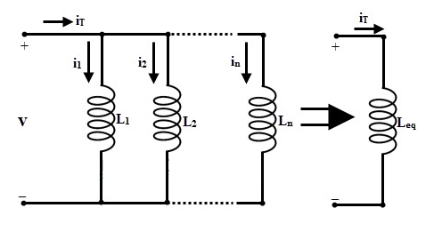
If the current flow through the each inductor is less than the total current,
the magnetic field generated by each inductor is also less than that of field generated by total current through it.
if the inductors are connected in parallel, current chooses least opposition path of inductor when current in that circuit is decreased or increased while each inductor individually opposes that change (increase or decrease of current).

Slide 4
Inductors Connected in Parallel (Without Magnetic Coupling)
The parallel connection of n inductors is shown in below figure.
Consider that there is no magnetic coupling between inductors and hence the total inductance equal to the sum of reciprocals of the individual inductances.

Slide 5
We know that, in a parallel network the voltage remains constant and the current divides at each parallel inductor.
If I_{L1}, I_{L2}, I_{L3} ……..I_{Ln} are the individual currents flowing in the parallel connected inductors L₁, L₂ ,………..L_{n}, respectively, then the total current in the parallel inductors is given by
I_{Total} = I_{L1} + I_{L2} + I_{L3} . . . . + I_{n}
If the individual voltage drops in the parallel connection are V_{L1}, V_{L2}, V_{L3} ……….V_{Ln}, then the total voltage drop between the two terminals V_{T} is
V_{Total} = V_{L1} = V_{L2} = V_{L3} . . . . = V_{n}
The voltage drop in terms of self inductance can be expressed as
V_{T} = L di/dt.
This implies total voltage drop,

Slide 6
V_{T} = L_{T} di/dt
=L_{T} d/dt (i_{L1} + i_{L2} + i_{L3} . . . . + i_{n})
=L_{T} { (di_{L1})/dt + (di_{L2})/dt + (di_{L3})/dt . . .}
Substituting V_{T} / L in place of di/dt, the above equation becomes
V_{T} = L_{T} (V_{T} /L₁+ V_{T} /L₂ + V_{T} /L3 . . . .)
1/L_{T} = 1/L₁ + 1/L₂ + 1/L₃ . . . . .
This means that the reciprocal of total inductance of the parallel connection is the sum of reciprocals of individual inductances of all inductors. The above equation is true when there is no mutual inductance is affect between the parallel connected coils.

Slide 7
Problem 1: If a circuit has 2 inductors of 20 Henry and 30 Henry connected in parallel, what will be the total inductance of the parallel arrangement?
Sol: We know that the formula for total inductance of series,
1/L_{T} = 1/L₁+ 1/L₂
Given that L₁ = 20 Henry
L₂ = 30 Henry
The total inductance is L_{Total} = _____Henry.

Slide 8
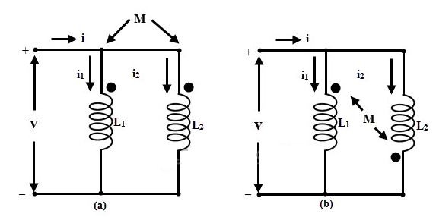
Mutually Coupled Inductors in Parallel
When there exist magnetic coupling between the inductors,
When the fluxes produced are in the same direction of magnetic flux, the mutual inductance will increase; these coils are called “Aiding” coils.
If the flux is in opposite direction to the magnetic flux, the mutual inductance will decrease; these coils are called “Opposing” coils.
Consider that two inductors are connected in parallel with self inductances L₁ and L₂, and which are mutually coupled with mutual inductance M as shown in below figure.

Slide 9
Parallel Aiding Inductors
Consider the figure (a), in which inductors L₁ and L₂ are connected in parallel with their magnetic fields aiding. The total current through the circuit is given as
i = i₁ + i₂
The voltage across parallel inductors is given as
Sub. equation 2 in equ1, we get

Slide 10
We know that
If L_{T} is the total inductance of the parallel inductor circuit , then voltage is given by
Substituting equation 2 in above equation, we get

Slide 11
Equating equations 3 and 4 we get
Simplifying the above equation, results

Slide 12
problem 2:If the two inductors 25mH and 45mH are connected in parallel aiding, calculate the total inductance of the parallel combination. The mutual inductance is given as 20mH.
SolGiven that, L₁ = 25 mH
L₂ = 45 mH
M = 20 Mh
= _______mH

Slide 13
Parallel Opposing Inductors
Similarly, if we consider the figure (b), in which inductors L₁ & L₂ are connected in parallel with their magnetic fields opposing, the total inductance is given as

Slide 14
Problem: If the two inductors 25mH and 45mH are connected in parallel opposing, calculate the total inductance of the parallel combination. The mutual inductance is given as 20mH.
Sol: Given that, L₁ = 25 mH
L₂ = 45 mH
M = 20 mH
= ______mH

Slide 15
Summary
Connecting the two terminals of inductor respectively to other inductor or inductors terminals, then that connection is referred as “parallel connection of inductors”.
When the fluxes produced by individual inductors are in the same direction, the mutual inductance will be increased; then these coils are called “Aiding” coils. Total inductance for aiding coils is L_{T} = (L₁ L₂– M²)/(L₁+ L₂ )-2M).When the fluxes produced by individual inductors are in the opposite direction of magnetic flux, the mutual inductance will be decreased; then these coils are called “opposing” coils. Total inductance for aiding coils is L_{T} = (L₁ L₂– M²)/(L₁+ L₂ )+2M)

